Slide 1
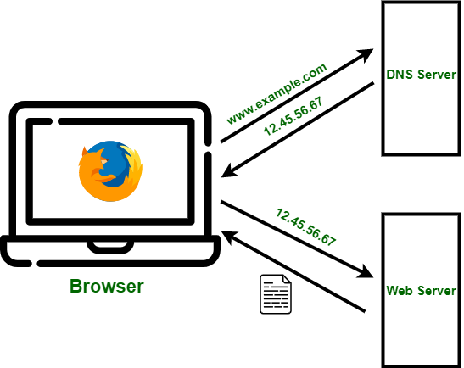
DOMAIN NAME SYSTEM
Understanding how DNS works and why it’s essential
-Ryan,Jatin,Awaiz & Ullas

Slide 2
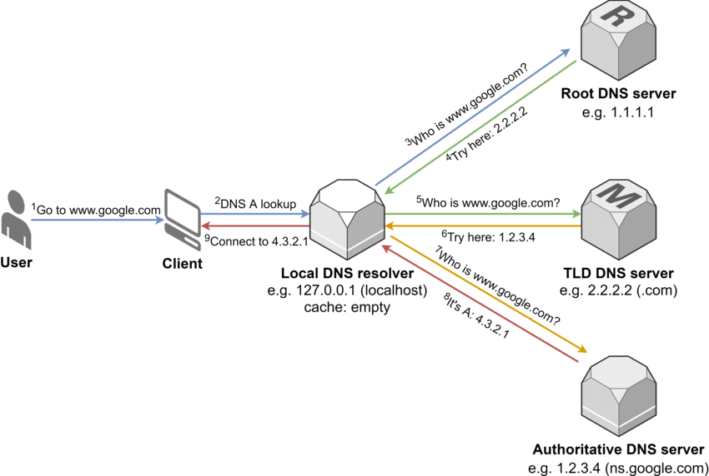
What is DNS?
Definition: DNS (Domain Name System) is the internet’s phonebook that translates human-readable domain names into IP addresses.
Purpose: Helps users access websites without memorizing complex numerical IP addresses.

Slide 3
IMPORTANCE OF DNS
Simplifies Internet Browsing – Converts domain names into IP addresses for easy access.
Reduces Human Error – Avoids the need to memorize complex numerical IPs.
Optimizes Network Efficiency – Caches DNS responses to speed up browsing.
Enables Load Balancing – Distributes traffic across multiple servers for better performance.
Supports Content Delivery Networks (CDN) – Directs users to the nearest server for faster load times.
Enhances Security – Protects against phishing, malware, and DNS spoofing.
Enables Domain-Based Email Services – Routes emails correctly using MX records.

Slide 4
COMPONENTS OF DNS
Domain Name – A human-readable name (e.g., example.com).
IP Address – A unique numerical address for a website (e.g., 192.168.1.1).
DNS Resolver – The first stop in a DNS query; finds the correct IP address.
Root Server – Directs the query to the correct Top-Level Domain (TLD) server.
TLD (Top-Level Domain) Server – Manages domains under .com, .org, etc.
Authoritative DNS Server – Holds the actual domain-to-IP mapping.
Recursive Resolver – Fetches data from other DNS servers if needed.
Caching Server – Stores previous DNS lookups for faster responses.
Zone Files – Configuration files containing DNS records for a domain.
DNS Records – Different types of DNS entries:

Slide 5
TYPES OF DNA RECORDS
A Record: Maps a domain to an IPv4 address.
AAAA Record: Maps a domain to an IPv6 address.
CNAME Record: Alias for another domain name.
MX Record: Specifies the mail server for emails.
TXT Record: Stores text-based information (e.g., security settings).
NS Record: Specifies the authoritative name servers for a domain.
PTR Record: Performs reverse DNS lookup (IP to domain).
SRV Record: Defines location of services (e.g., VoIP, SIP).

Slide 6
1. Public DNS Providers (Faster & More Secure Alternatives to ISP DNS)
Google DNS – 8.8.8.8, 8.8.4.4 (Fast and reliable, but logs data)
Cloudflare DNS – 1.1.1.1, 1.0.0.1 (Privacy-focused, no logging)
OpenDNS (by Cisco) – 208.67.222.222, 208.67.220.220 (Security-focused)
Quad9 DNS – 9.9.9.9 (Blocks malicious domains for security)
Comodo Secure DNS – 8.26.56.26, 8.20.247.20 (Security and phishing protection)
2. Types of DNS Servers
Recursive Resolver – Finds IP addresses for domain names by querying other servers.
Authoritative DNS Server – Stores and provides actual domain-to-IP mappings.
Caching DNS Server – Temporarily stores DNS responses for faster access.
Forwarding DNS Server – Passes queries to another DNS server for resolution.
Anycast DNS Server – Uses multiple global locations to provide the nearest response.

Slide 7
Working of A DNS Server
1. User Request
2. Check Local Cache
3. Check Host Files
4. Query DNS Resolver
5. Contact the Root Server
6. Query TLD Server
7. Query the Authoritative Server
8. Retrieve the IP Address
9. Return IP Address to Resolver
10. Connect to the Real Server

Slide 8
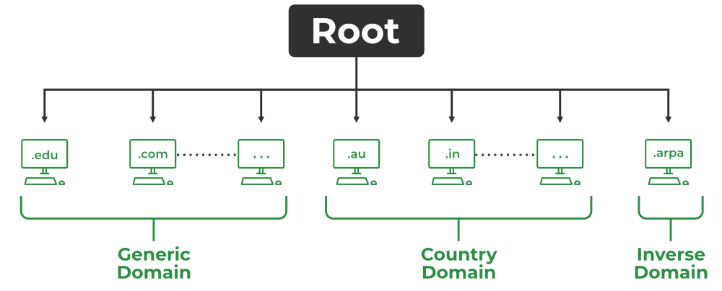
Working of DNS Server

Slide 9
Working of DNS Server
DNS Lookup
Process of translating a human-readable domain name (like www.example.com) into its corresponding IP address (like 192.0.2.1), which computers use to locate and communicate with each other on the internet.

Slide 10
Working of DNS Server
DNS Resolver
Using the DNS Resolver, applications can easily access different websites and services present on the Internet by using domain names that are very much friendly to the user and that also resolves the problem of remembering IP Address.

Slide 11
Working of DNS Server
DNS Caching
Process used by DNS Resolvers for storing the previously resolved information of DNS that contains domain names, and IP Addresses for some time.

Slide 12
Applications of DNS
Understanding the Role of Domain Name System in Networking

Slide 13
Applications of DNS
Web Browsing: Resolves domain names to IP addresses.
Email Services: Used in mail exchange (MX) records.
CDNs: Helps in delivering content efficiently by directing users to the nearest servers.
Load Balancing: Distributes network traffic across multiple servers.
Security: DNS filtering, DNSSEC for integrity, and protection against phishing.

Slide 14
Future of DNS
Enhanced security with DNS over HTTPS (DoH) and DNS over TLS (DoT).
Growing role in IoT and cloud computing.
AI-driven DNS optimization for better performance.

Slide 15
Why is DNS Important?
Simplifies Access → Users can type example.com instead of memorizing 192.168.1.1.
Scalability → Supports billions of devices worldwide.
Load Balancing → Distributes traffic across multiple servers.
Security Features → Uses DNSSEC to prevent spoofing and phishing attacks.

Slide 16
DNS Security Issues & Solutions
The Domain Name System (DNS) is essential for internet communication, but it has security vulnerabilities that attackers can exploit. Below are some common DNS threats and their solutions.

Slide 17
Common DNS Security Issues
DNS Spoofing (DNS Cache Poisoning)
Attackers inject false DNS records into a resolver’s cache, redirecting users to malicious sites.
Example: You type bank.com, but due to poisoning, it takes you to a phishing page.
DDoS Attacks (Distributed Denial of Service)
Attackers overwhelm DNS servers with massive traffic, making websites inaccessible.
Example: Botnets flood DNS servers with fake requests, causing downtime.
DNS Hijacking
Attackers modify DNS settings to redirect users to malicious servers.
Example: Your ISP or malware changes your DNS settings to serve ads or steal data.

Slide 18
DNS Spoofing (DNS Cache Poisoning)
What is it?
Attackers inject false DNS records into a resolver’s cache, tricking users into visiting malicious websites instead of the intended destination.
How it works:
The attacker sends fake DNS responses to a resolver before it gets a legitimate response.
These fake records are stored in the cache, leading users to a phishing or malware-infected site.
Example:
You type bank.com, expecting to reach your bank’s website.
Due to cache poisoning, your browser is redirected to a fraudulent page that looks identical to the real site.
If you enter your credentials, hackers can steal your login details.
Impact: Phishing attacks, credential theft, financial fraud.

Slide 19
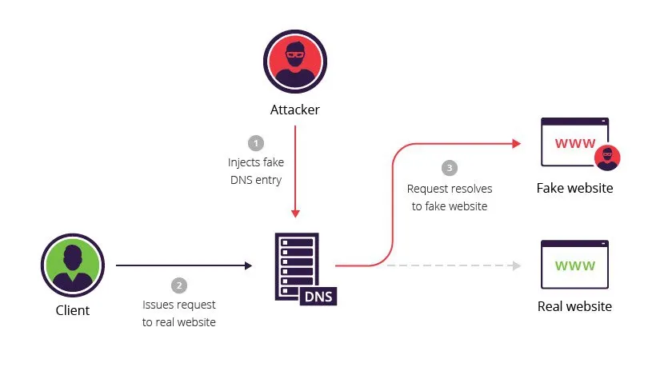

Slide 20
2.DDoS Attacks (Distributed Denial of Service)
What is it?
Attackers flood DNS servers with an overwhelming number of queries, causing slowdowns or making websites completely inaccessible.
How it works:
A botnet (a network of compromised computers) sends massive amounts of fake DNS requests to a target server.
The DNS resolver gets overloaded and fails to respond to legitimate users.
Example:
A botnet sends millions of fake DNS queries to a major DNS provider (e.g., Cloudflare, Google).
The provider's servers struggle to respond, making many websites unreachable.
Impact: Website downtime, loss of revenue, degraded performance.

Slide 21
3. DNS Hijacking
What is it?
Attackers modify DNS settings to redirect users to malicious sites or inject ads into their browsing experience. This can be done by malware or even rogue ISPs.
How it works:
Malware changes a user’s DNS settings, making all internet traffic go through a malicious server.
A rogue ISP may redirect traffic to advertisement pages for profit.
Example:
You type facebook.com, expecting the real site.
Your hijacked DNS redirects you to a fake login page that steals your credentials.
Impact: Identity theft, ad injection, surveillance, data theft.

Slide 22
Solutions to These DNS Attacks
To mitigate these threats, organizations and individuals can implement security measures like:
DNSSEC (Domain Name System Security Extensions) – Uses digital signatures to verify DNS responses and prevent spoofing.
Use Trusted DNS Resolvers – Google Public DNS (8.8.8.8), Cloudflare (1.1.1.1), OpenDNS.
DNS Over HTTPS (DoH) & DNS Over TLS (DoT) – Encrypts DNS queries to prevent interception.
Rate Limiting & Anomaly Detection – Helps mitigate DDoS and NXDOMAIN attacks.
Firewall & Network Monitoring – Detects suspicious activity and prevents unauthorized changes.

